Slide 1
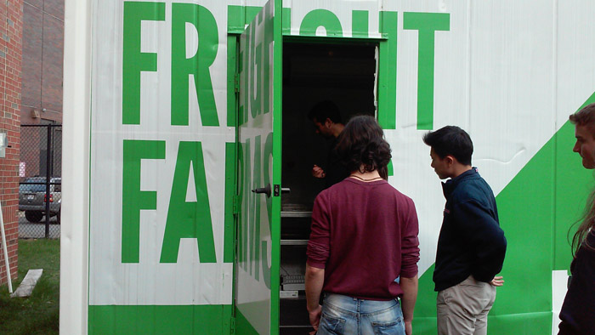
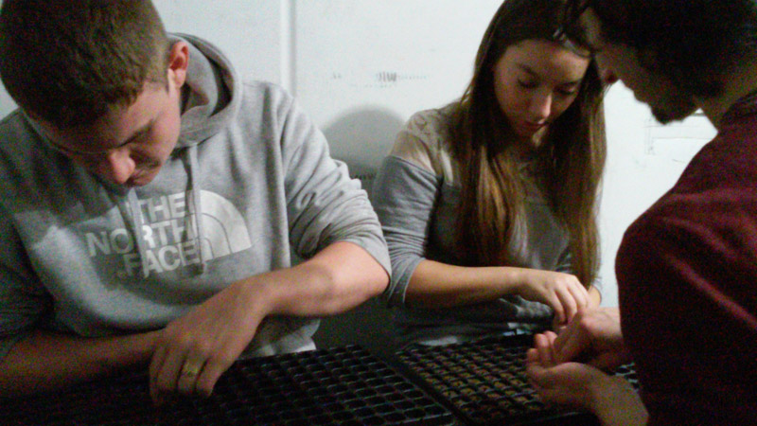
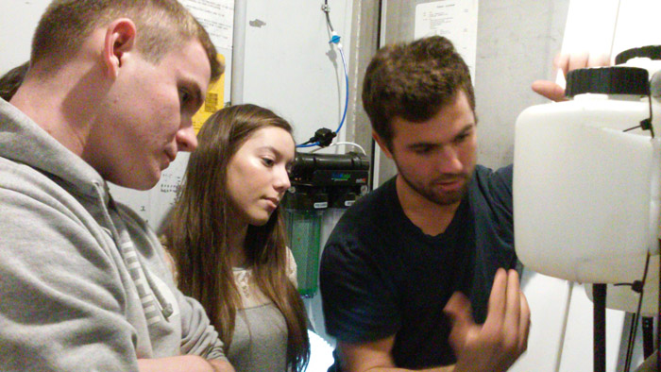
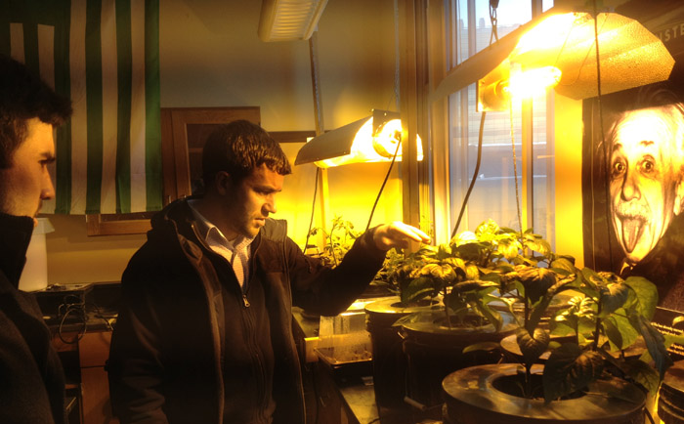
Implementing and Promoting Freight Farm in School and Community
The Freight Farm is an innovative hydroponics growing system in a repurposed shipping container that grows food sustainably and is completely run by students. In an urban environment, they are a possibly sustainable option since they employ land-conserving technology and
Boston Latin School students have been trained to run the Freight Farm.
Environmental science teacher Timothy Gay partnered with Freight Farm staff to supervise student training of the Freight Farm
A plan to integrate the Freight Farm into the school environmental science curriculum has been implemented.
Timothy Gay has incorporated the Freight Farm his curriculum so students can use it as a tool in class projects, and it is also offered as an opportunity for leadership and community service learning.
Students hold tours of the Freight Farm to share the sustainability opportunities of hydroponic farming
We partnered with Northeastern University and gave tours to students of Professor Monika Kondura, who teaches courses in sustainability and climate change in the School of Social Policy and Urban affairs and has visited the Freight Farm three times.
6th grade students from Genesee Charter School in Rochester, New York, have also visited to learn about Boston Latin School’s sustainability projects, and were given a student-led tour of the Freight Farm.
Outside of the Freight Farm
Students working on the Freight Farm
Freight Farm staff educating students about maintenance
Timothy Gay includes elements of the Freight Farm in his classroom

Slide 2
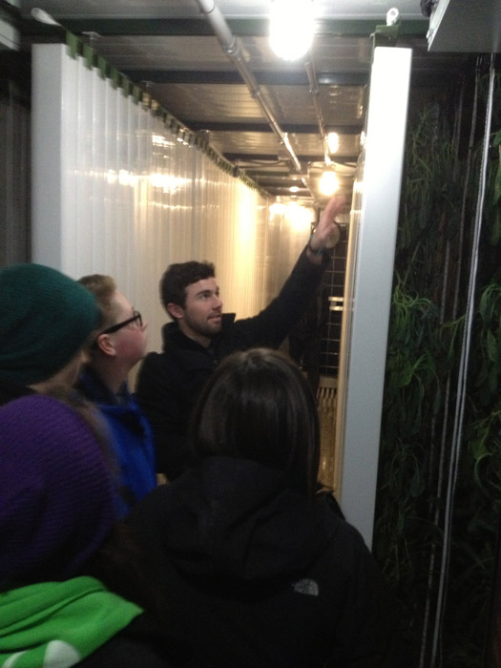
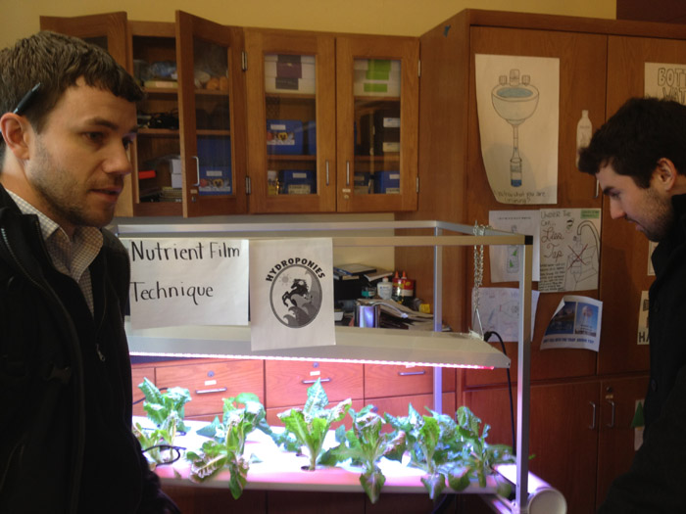
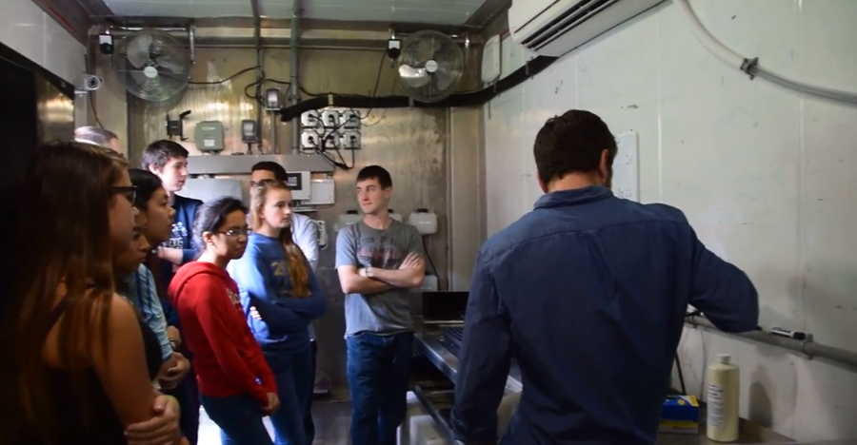
Implementing and Promoting Freight Farm in School and Community (Cont.)
The Freight Farm has been publicized through community art projects such as the designing and painting of the Freight Farm mural.
The mural was designed by Yinyu Ji, a current sophomore at Boston Latin School, and consists of the Boston city skyline. The skyline is filled in with a leaf pattern, which is a representation of Boston and the beginning of the integration of urban agriculture in the city.
Students have been developing a marketing program to make Boston Latin School families and faculty aware of the Freight Farm so they can get involved in the community supported agriculture program.
In the program, students will be responsible for marketing the vegetables and will have to describe the health benefits of eating the different vegetables as part of their promotional tools and campaign.
The garden will be a tool to teach the entire community about healthy eating habits and students will be spearheading the educational outreach efforts through the community supported agriculture program.
We will be distributing the produce grown in the Freight Farm to Boston Latin School families
We are also working on setting up an arrangement to share leftover produce with food pantries in the area.
We are in the process of creating a website to document the progress of the Freight Farm, which will be a place where the community can find out about the Freight Farm and where students can learn more about hydroponics.
Students from Northeastern University are given a tour of the Freight Farm
Timothy Gay teaching about nutritional value of plants in the classroom
Freight Farm mural design
More students on tour

